Slide 1
Zomato Analysis
Presented by:-
1. Pammi Yadav 2. Ankita Wadte
3.Prachi Raichura 4.Redhu A.
5.Durgesh Singh 6.Sibasis Rath
7.Hamza

Slide 2
INDEX
KPIs and their observations.
Suggestion and conclusion
Excel dashboard
Power BI dashboard
Tableau dashboard
SQL Analysis
Challenges faced and Solutions

Slide 3
KPI-1: Country Map Table
Content:
Created a mapping table for Country Code → Country Name.
Joined with the main dataset using "Country Code“.
Observation:
Top countries with most Zomato restaurants.
E.g., India has the highest number of restaurants.
Identify markets with low or no representation on Zomato.

Slide 4
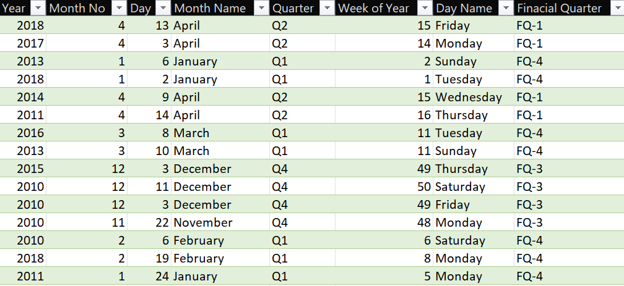
KPI-2: Calendar Table Creation
Content:
Calendar table built using “Opening Date”.
Fields created:
Year, Month No, Month Name.
Quarter, Year-Month.
Weekday No, Weekday Name.
Financial Month, Financial Quarter.
Observation:
Enables time-based analysis.
Key to trend spotting in restaurant openings.

Slide 5
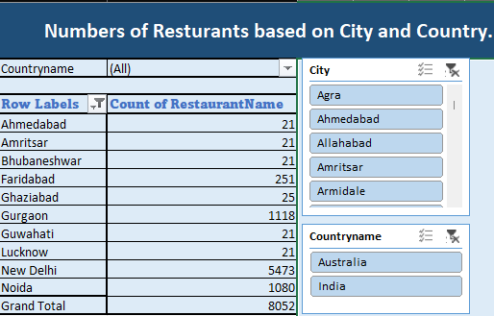
KPI-3: Restaurants By City and Country
Content:
Grouped data by City and Country.
Visual: Heatmap or Bar Chart.
Observation:
Top Cities:
New Delhi, Noida, Gurgaon lead in count.
International Presence:
Countries like Australia, show limited but premium listings.

Slide 6
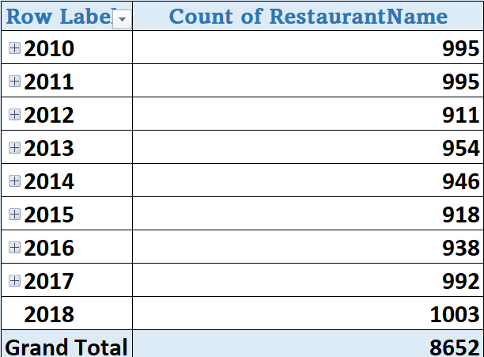
KPI-4: Restaurant Openings by Time.
Content:
Analyzed new openings by:
Year
Quarter
Month
Visuals:
Line chart or stacked bar chart
Observation:
Peak openings in [e.g., 2010,2011 &2018].
Monthly trends show high activity during festive seasons (Oct–Dec).

Slide 7
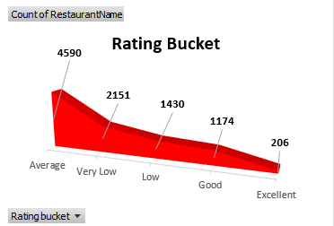
KPI-5: Count of Restaurant based on Average Ratings.
Content:
Analyzed the number of restaurants on their average rating by creating bucket.
Visuals:
Basic area chart.
Observation:
4590 number of restaurants have average rating.
206 number of restaurants have the excellent rating.

Slide 8
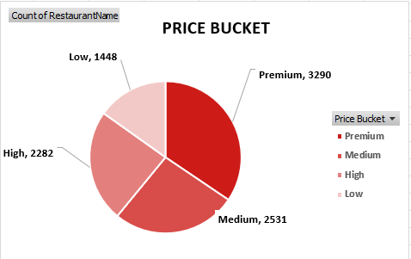
KPI-6: Buckets based on Average Price of reasonable size
Content:
Analyzed the count of restaurant on average price of reasonable size
Visuals:
Pie chart
Observation:
3290 number of restaurants have premium price.
1448 number of restaurants have the low price.

Slide 9
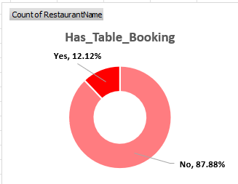
KPI-7: Percentage of Restaurants based on "Has_Table_booking".
Content:
Analyzed how many restaurants has table booking available.
Visuals:
Donut chart
Observation:
87.88% of restaurants don’t have table bookings.
12.12% of restaurants have table bookings.

Slide 10
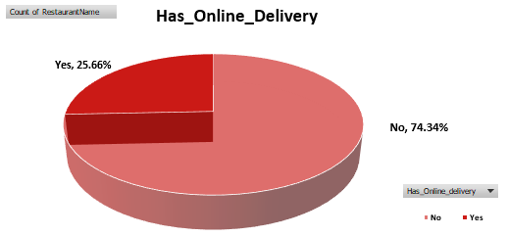
KPI-8: Percentage of Restaurants based on "Has_Online_delivery"
Content:
Analyzed how many restaurants are having online delivery.
Visuals:
3D Pie chart
Observation:
25.66% of restaurants are having online delivery.
74.34% of restaurants are not having online delivery.

Slide 11
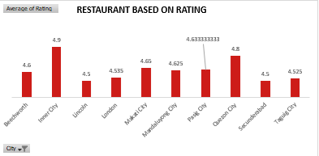
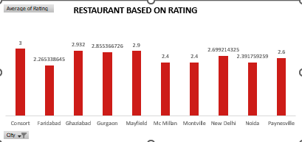
KPI-9: Restaurants based on Average Ratings
Content:
Analyzed the average rating of restaurants across different cities.
Visuals:
clustered column chart
Observation:
Inner city has highest of 4.9 rating .
Faridabad has lowest of 2.26 rating.

Slide 12
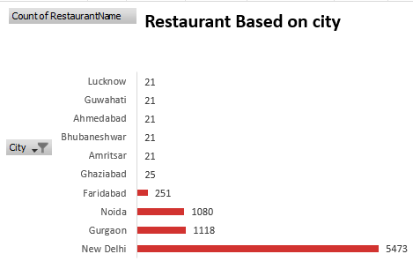
KPI-9: Restaurants based on city
Content:
Analyzed the number of restaurants across different cities.
Visuals:
clustered bar chart
Observation:
New Delhi has the highest number of restaurant 5473 .
48 number of cities have only 1 restaurant.

Slide 13
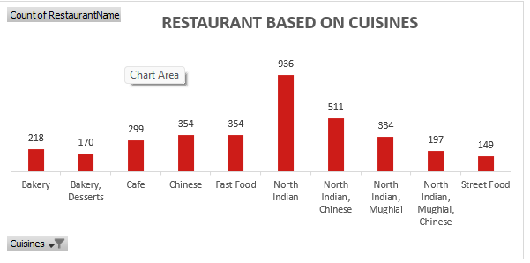
KPI-9: Restaurants based on cuisines
Content:
Analyzed the number of restaurants based on different cuisines.
Visuals:
clustered column chart
Observation:
North Indian cuisines has the highest number of restaurants.

Slide 14
Suggestion and Conclusion
Increase table booking option : Encourage partner restaurants to enable table booking through the platform.
Target Mid-Priced Segment : Promote value meal combos and discounts in this range to retain price-sensitive customers and drive more frequent orders.
Focus on Ratings Improvement : Encourage quality improvement via customer feedback, reward higher-rated restaurants with better visibility on the app.

Slide 15

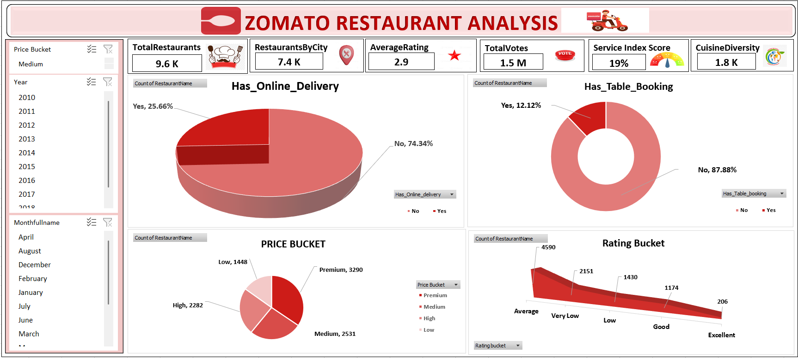
EXCEL’S DASHBOARD

Slide 16
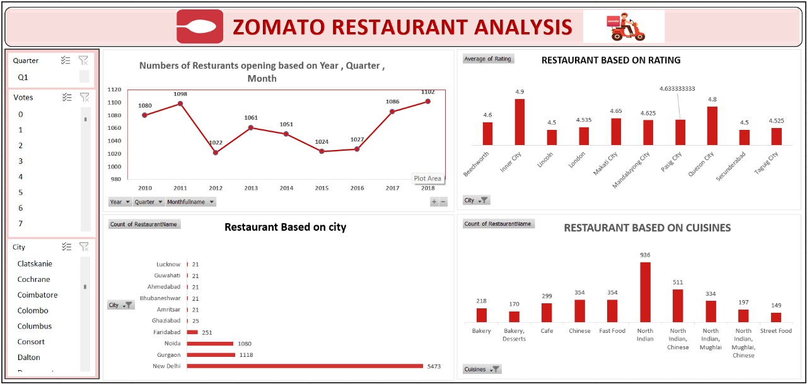
EXCEL’S DASHBOARD

Slide 17
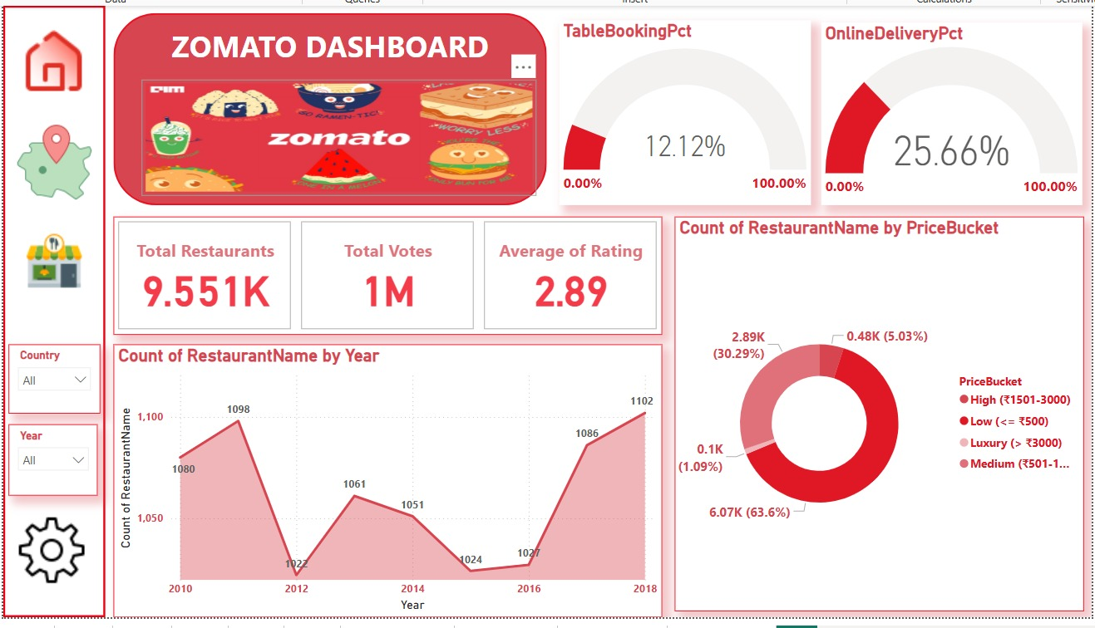
POWER BI DASHBOARD

Slide 18
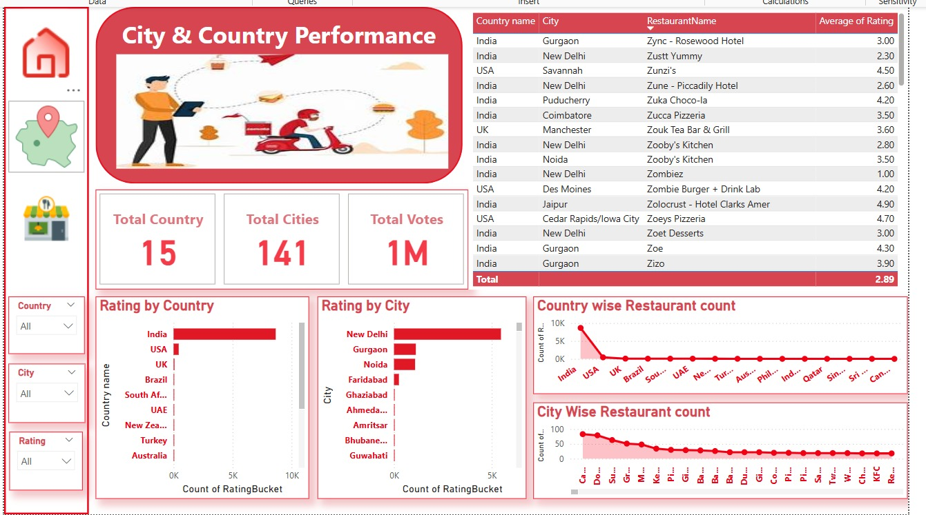
POWER BI DASHBOARD

Slide 19
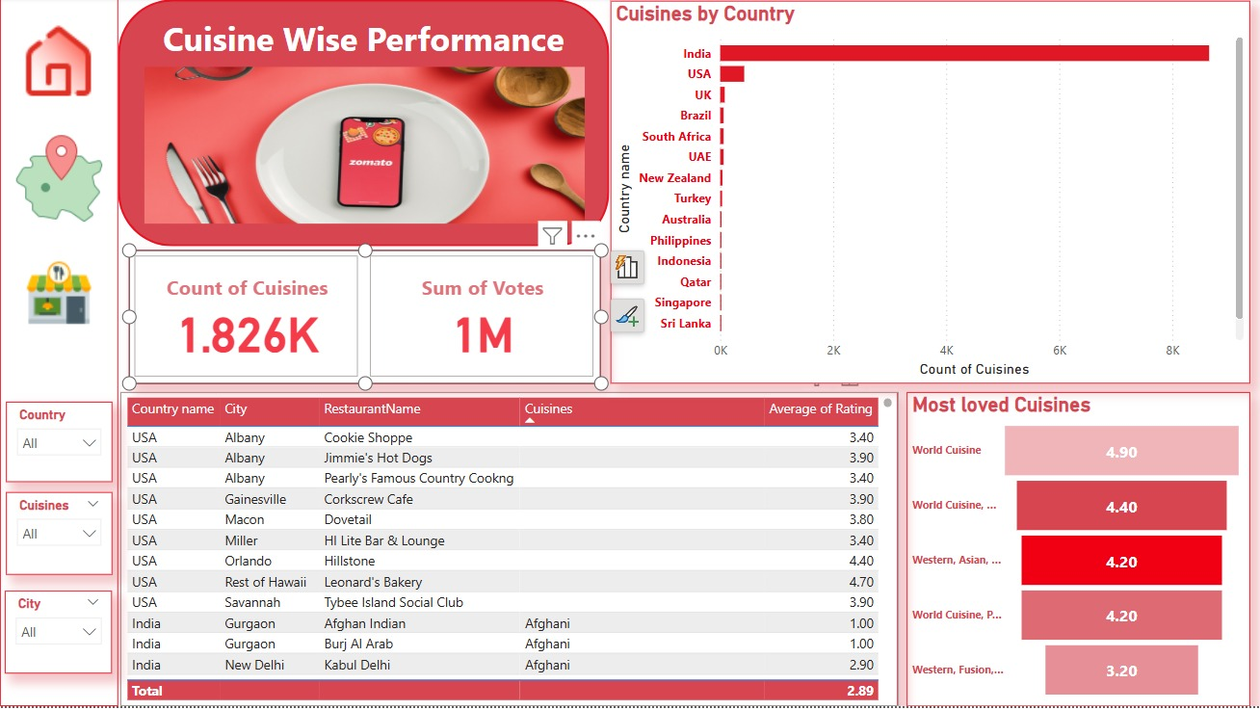
POWER BI DASHBOARD

Slide 20
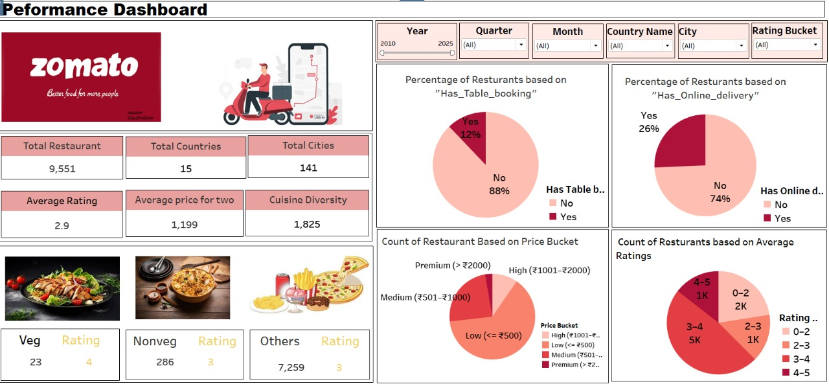
TABLEAU DASHBOARD

Slide 21
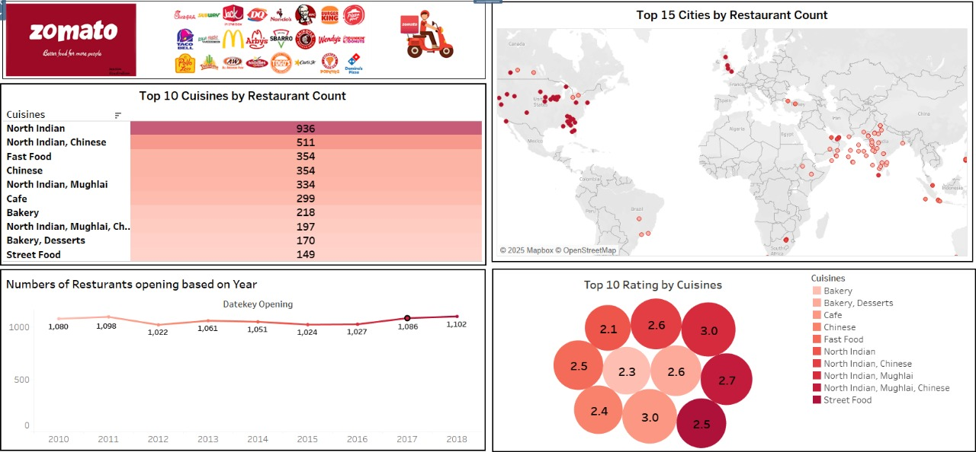
TABLEAU DASHBOARD

Slide 22
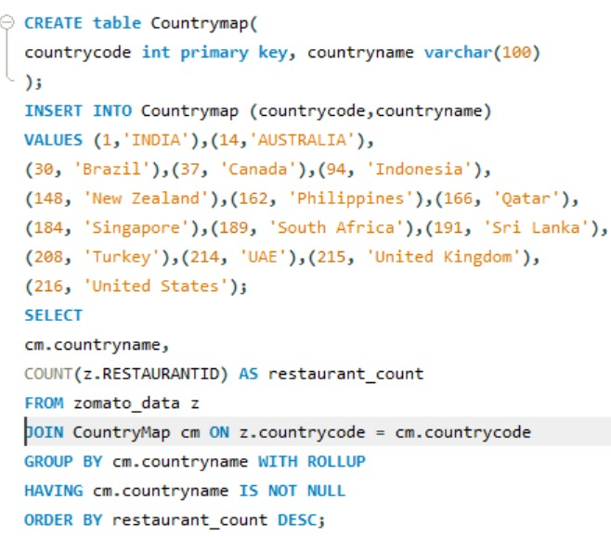
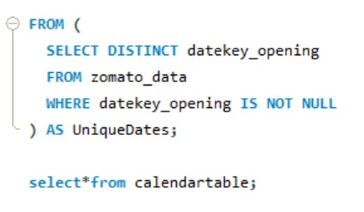
SQL ANALYSIS

Slide 23
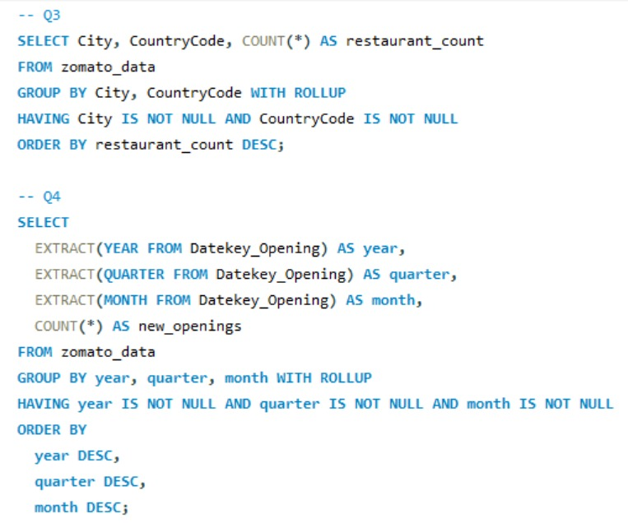
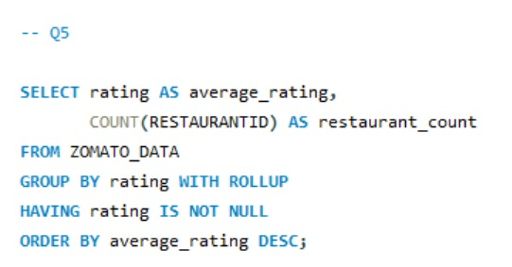
SQL ANALYSIS

Slide 24
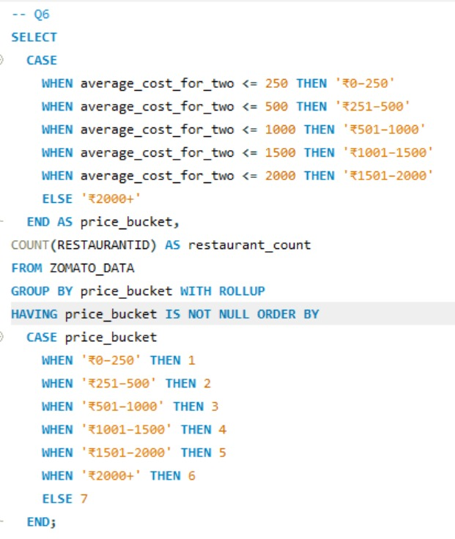
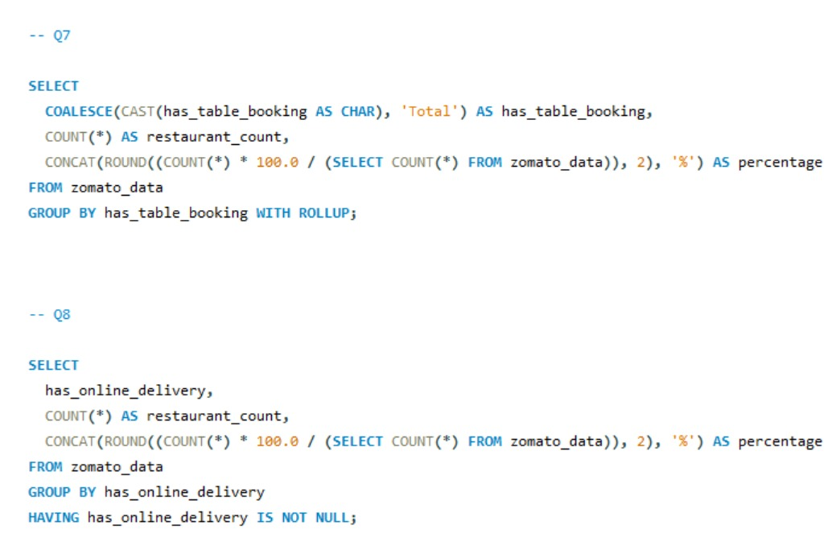
SQL ANALYSIS

Slide 25

 | CHALLENGES FACED AND SOLUTIONS
Handling a large dataset in Excel (frequent crashes and lag).
Solution: Split the data into manageable chunks and used Power Query for efficient data transformation. Reduced file size by removing unnecessary formatting and volatile formulas.
Loading a large dataset into MySQL from Excel.
Solution: Converted the Excel file into CSV format and used LOAD DATA INFILE in MySQL for faster and more stable import, instead of relying on the GUI Import Wizard.
Handling NULL values while using ROLLUP in SQL queries.
Solution: Used IFNULL() or COALESCE() functions to replace NULLs with meaningful labels like "Total" or "Unknown" for better readability in grouped results.

Slide 26


